Slide 1
THE LITERATURE REVIEW & THE SIX STEPS
March 14, 2019
By Marion Hayes, University Librarian
ITU Library Website

Slide 2
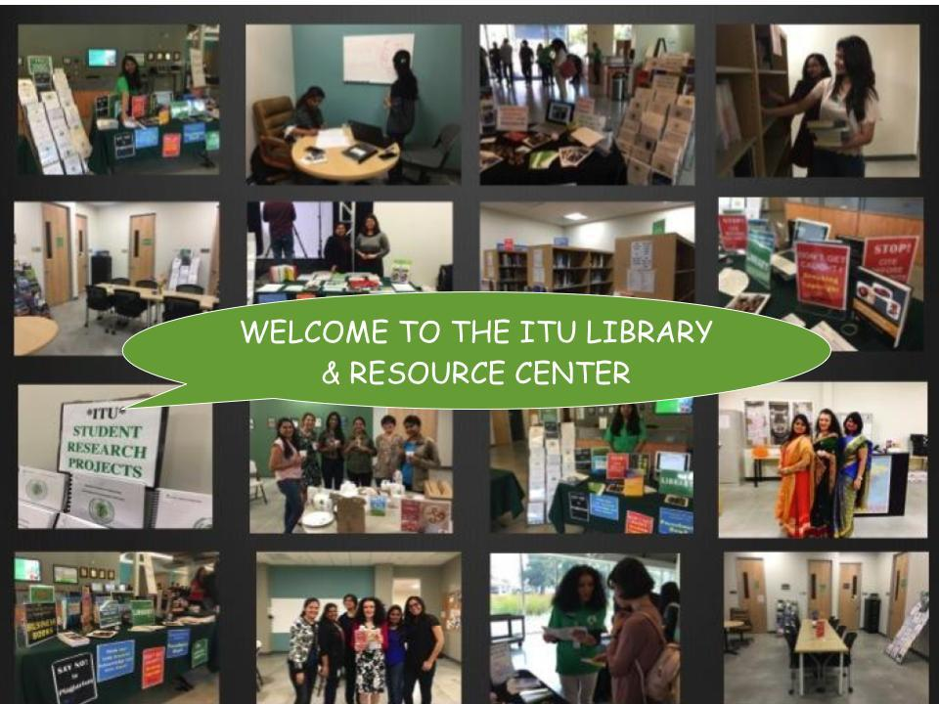
2
ITU Library Website
2711 North First St. - San Jose, CA 95134 - www.itu.edu
library@itu.edu
6/27/16
5/18/17

Slide 3
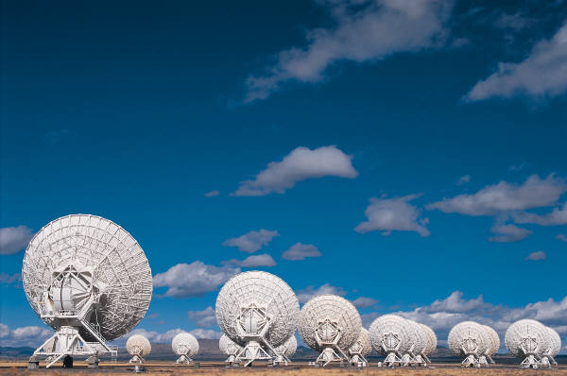
THIS WORKSHOP WILL HELP YOU:
#1: Review the 6-step formula to plan, search sources, write and cite your research paper
#2: Know the difference between a literature search, literature review and the research paper
#3: Write a research paper supported by a scholarly review of relevant literature
ITU Library Website
5/18/17

Slide 4
LET’S START
With the word “Review”
Look at – bring someone up-to-date
Snapshot
Extract major sources and from them major concepts or common themes or relationships between the concepts
Not a detailed or in-depth write up
ITU Library Website
5/18/17

Slide 5
LET’S START
With the word “Literature”
Major works published
About a narrow topic
Published peer-reviewed sources
Usually ‘private web’ subscription research and library databases
Not ‘open web’ of newsy, commerce-orientation
ITU Library Website
5/18/17

Slide 6
NOW LET’S START
With the word “Literature Review”
‘Reader Service’ – a ‘favor’ – bring someone up to date
Snapshot of major sources
Summarize major concepts from the relevant sources
Organize and write by identifying major concepts, common themes or relationships between concepts
Not detailed or in-depth write up, though
Process: 1. Collect sources 2. Analyze (skim/select) 3. Outline/Arrange – chronological or Advancement or Geographical or Researcher’s Questions? 4. Summarize
ITU Library Website
5/18/17

Slide 7
ESSENTIAL RESEARCH TOOLS
On the ITU Library Website
#1: Library Catalog & E-Resources
#2: Master’s Thesis Guidelines
#3: Doctoral Dissertation Guidelines
#3: ITU Style guides, APA Format
#4: ITU Plagiarism Prevention Policy
#5: Fake or Fact: Library Workshop
#8: Say No to Plagiarism: Library Workshop
ITU Library Website
5/18/17

Slide 8

Highly Recommended
Taylor, David. University of Maryland University College. Effective Writing Center Tutorial. Writing the Literature Review (Part 1-3): Step-by-step Tutorial for Graduate Students
https://www.youtube.com/watch?v=2IUZWZX4OGI
B
After watching David’s tutorials you will know:
what a literature review is (and is not)
how to collect, analyze, arrange and summarize peer-reviewed sources for your narrow topic
You will also learn how to ‘write’ the literature review.
B
ITU Library Website
5/18/17

Slide 9
ACTIVITY #1 (After Webinar)
Watch Parts 1 & 2 of the Uni of Maryland tutorial.
Review Questions
What does David say the LR is not?
What is a literature review?
List 4 ways to organize your literature
What is the process for writing your LR?
ITU Library Website
5/18/17

Slide 10
ANSWERS (After Webinar)
Watch Parts 1 & 2 of the Uni of Maryland tutorial
Review Questions
Not a Research paper, essay or prove an argument
Part of the paper, essay or argument – main, selected, quality organized (see 3) peer-reviewed academic sources about your ‘narrow’ topic (not everything that was ever written)
Organized in these ways: Chronological, Advancements, Geographical, Questions
How to do a LR: Collect sources, Analyze (skim, select, reject), Arrange (patterns, chronolog, Qs), Summarize, (integrate/bring together in some way), write+cite sources (in-text & at end)
ITU Library Website
5/18/17

Slide 11
Information / Research Cycle
Define Purpose
TASK:
Question
Decision
Problem
Argument
Review
Comparison
Criticism
←←←←←
Reflect
Search Access
Acknowledge
Cite
Write
Communicate
Honesty
⬅
**
Acknowledge, Cite, Ethical Use
Evaluate Select
Think Question Search Select Review Summarize Cite Write Cite Re-write Final Review Bibliography
Use Apply
Based on: Framework for Information Literacy for Higher Education,. Association of College & Research Libraries (ACRL) 2000.
ITU Library Website

Slide 12
THE SIX STEPS
#1: Choose your topic
#2: Find Information (scholarly)
#3: State your thesis (hunch or guess)
#4: Organize notes & draft outline
#5: Citations & acknowledgement
#6: Write & review several drafts & bibliography (plagiarism checker!)
A good paper will be a back-and-forth process among the six steps until you are satisfied you have written an honest scholarly paper.
ITU Library Website
5/18/17

Slide 13
STEP 1: Topic
#1: Select or given
#2: Simplify & limit – keywords, phrases
#3: Manageable – time avail., scope
#4: Write in one sentence
#5: Original research or literature review?
#6: A paper is a formal written report; includes research findings student’s ideas.
Your topic depends on : time available, type of paper, scope & information available
ITU Library Website
5/18/17

Slide 14
Step 1…continued
Step 1: Develop your topic:
Select, narrow down & develop topic –– Keywords, synonyms , wildcards (* #) background info, Boolean (and, or, not)
Useful reference: Start Your Research, Martin Luther King, Jr.
https://library.sjsu.edu/start-your-research/start-your-research
ITU Library Website
5/18/17

Slide 15
STEP 2: Scholarly Information
Locate “scholarly” information:
Search engines: Dogpile, Bing, Google Scholar
Google “Settings>Advanced Search>
Subscription databases : ITU Library Catalog, ACM, Ebsco, NYTimes
Types: Primary: Raw data, news report; Secondary: Books, e-books, articles, videos, images, websites - .gov, .edu, .org
Open Educational Resources (OER): Educause OER
Citation tools: Reference Managers (Mendeley, Zotero), Citation Styles (APA)
Other style guides, e.g. IEE, MLA, Harvard
Reliable Accurate Honest Unbiased, Timely Relevant
Authoritative
Domain or
Publisher
ITU Library Website
5/18/17

Slide 16
LIBRARY DATABASES
What library databases does ITU have
eLibrary tab in the EMS (onsite no passwords; login for off-site
ITU Online Library Catalog
ACM Digital Library
EBSCO Business Source Elite
NYTimes Academic Pass
Proquest Wall Street Journal
What are the best local libraries for research?
Joint SJPL & SSJU library (e.g. see LibGuides – 100s of databases)
Santa Clara University (e.g. see LibGuides – 100s of databases)
CA Public Libraries (e.g. Safari Books, Ebsco Source Elite
Google
Wikipedia
Library Databases
ITU Library Website
5/18/17

Slide 17
OPEN ACCESS (OA)
OPEN EDUCATIONAL RESOURCES (OER)
OA - online research outputs free of all restrictions on access and use (Wikipedia: https://en.wikipedia.org/wiki/Open_access
OER - free and openly licensed educational materials that can be used for teaching, learning, research, and other purposes (Creative Commons,https://wiki.creativecommons.org/wiki/What_is_OER%3F)
Examples:
ITU Electronic Information Resources (.xls) on the library website
Directory of Open Access Journals (DOAJ)
Arxiv.org
MIT Open Courseware
MSU Open Courseware
ITU Library Website
5/18/17

Slide 18
OPEN ACCESS (OA)
OPEN EDUCATIONAL RESOURCES (OER)
Local Library
University Library
State or National Library
Online Libraries (Internet Archive, Open Library
Free Preprints & Repositories
University Repositories
University Libraries
Subject Repositories (Openly Published – Medline)
Google Scholar
Pay-per-view
Examples:
ITU Electronic Information Resources (.xls) on the library website
Directory of Open Access Journals (DOAJ)
Arxiv.org
MIT Open Courseware
MSU Open Courseware
Trove, WorldCat – World libraries holdings
Subject Databases - Medline
ITU Library Website
5/18/17

Slide 19
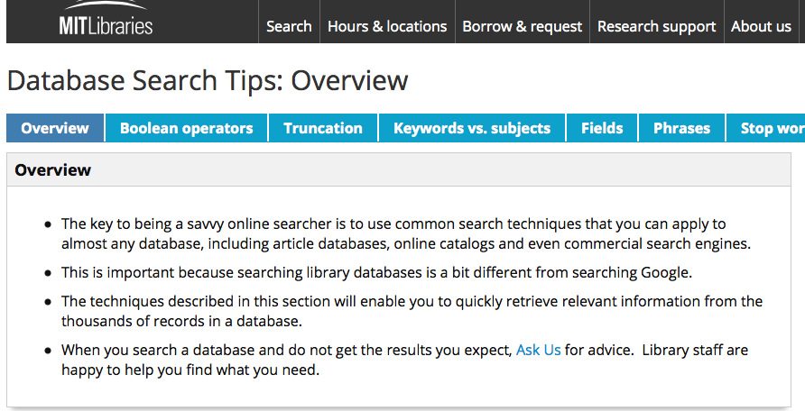
Scholarly Surfing
Highly Recommended Source: MIT Libraries, https://libguides.mit.edu/database-search, Accessed 18 January, 2018
ITU Library Website

Slide 20
SEARCH TIPS
What common search tips and tools are used in most databases?
Example: MIT Search Tips Guide (Excellent)
Topic / question in one sentence
Background info (e.g. Wikipedia or Google)
Keywords or synonyms (similar)
Search strings
Boolean Operators AND, OR, NOT
Wildcards, truncation ? # book?
Stop word (e.g. ‘NOT’)
Sub topics
Keywords
Scholarly?
Limit?
Highly Recommended Source!!
MIT Libraries Search Tips, https://libguides.mit.edu/database-search, Accessed 18 Jan, 2018
5/18/17

Slide 21
STEP 2 … continued
Revisit your purpose/audience – Evaluate for relevance, appropriateness, authorship, reputation, scope/coverage, accuracy, objectivity/bias, currency,
Scholarly?: Periodical or popular magazine? Blog? Tweet? Audience/purpose?
Reliable Accurate Honest Unbiased, Timely Relevant
Authoritative
Domain or
Publisher
ITU Library Website
5/18/17

Slide 22
STEP 3 & 4: Organize & Draft
Plan/outline: Outline your paper, purpose, goal/objectives, audience
Intro: State thesis & purpose clearly - chief reason for the paper? Why should the reader be interested?
Body: Clearly stated arguments to support your thesis statement.– three supporting arguments for each position (use evidence)
Concl.: Restate your thesis, critically compare, contrast, synthesize & summarize your arguments. Why have come to this particular conclusion. Is it objectively supported?
Grammar: Sentence structure, punctuation!! Use a spell-checker
Reliable Accurate Honest Unbiased, Timely Relevant
Authoritative
Domain or
Publisher
ITU Library Website
5/18/17

Slide 23
STEP 5: Citations & Acknowledgement
1. ITU Style Guides – APA, ACM, IEEE
2. APA Tutorial, Johnson & Wales Univ.
http://pvd.library.jwu.edu/apa_manual
3. Owl Purdue Online Writing Lab
https://owl.purdue.edu/owl/research_and_citation/apa_style/apa_style_introduction.html
Bib details
Bibliog sw
Paraphrase
Quote
Acknowedge
Cite APA
Style Guides
Fair Use
ITU Library Website
5/18/17

Slide 24
Citations & Reference Managers
Citation: Reference to or quote from a source
Acknowledge an idea, opinion or excerpt from a source that is not your own. It is
Support your idea and build argument
Avoid accusations of plagiarism
Reference Manager (Demonstration by Janani)
Search, collect, manage and cite sources
Zotero, Endnote, Mendeley, ReadCube
Automatic bibliography – save time & grief
ITU Library Website
5/18/17

Slide 25
When to Cite? Permission Recommended *
Paraphrase text
Quote text
* Use Image, illustration, graphic, video
* Use Code,
* Use ‘Open Source’ (etiquette)
List of References used
Bibliography (summative)
Annotated bibliography
Literature review
ITU Library Website
5/18/17

Slide 26
ITU Citation Tools
APA Style Guide: Publication of the American Psychological Association. Call: BF76.7 .P83 2010
The dissertation journey. Call #: LB1742 .R63 2010
Main Referencing Methods:
APA Style Guide (ITU recommended link)
IEEE Author Digital Tools
ACM Publishing Guidelines
MLA
Harvard Style
ITU Library Website
5/18/17

Slide 27
What is a Reference Manager
“graduate student’s best friend” – American Psychological Association (APA)
Create your personal “library” of references / citations
Field structure for most library database structures, EBSCO
Copyright – DO NOT download full text unless “open source”
Common: Zotero Mendeley ReadCube $ Endnote, RefWorks
Free or subscription-based; choose best fit for needs
ITU Library Website
5/18/17

Slide 28
Criteria: Choosing a Reference Manager
PC or Mac
Style guides supported – APA, MLA, Harvard
APA Review of three commonly used & FREE
Import formats – Ebsco, Proquest, Pubmed
Free or $ (I like Endnote - $$)
Word Processor Integration – Note!
Comparison of Reference Managers – Note!
APA-Compatible Managers – Note!!
ITU Library Website
5/18/17

Slide 29
DEMONSTRATION
How to Set Up Your Reference Manager
By Janani
Comparison of Reference Managers
Setting up your [database] structure
Populating your database
Importing from databases (ACM, EBSCO Bus Source, Promed, IEEE)
Manually entering a reference
Creating your bibliography
ITU Library Website
5/18/17

Slide 30
STEP 6: Write & Review …
Review outline – intro, body, conclusion; re-write
Collect information, copies of reviewed articles
Choose style guide & other formats
As you write, use in-text referencing
Adhere to “fair use” when quoting & paraphrasing
Check for plagiarism, honesty (bias), objectivity, copyright
Check grammar, spell check, plagiarism checker
Draft and re-draft as you critically review, synthesize, paraphrase & cite to form your main ‘body’ or argument. Conclude with Qs for further research or discussion.
ITU Library Website
5/18/17

Slide 31
STEP 6: Write & Review …
Organize, analyze, synthesize, sort and digest information
Effectively communicate your thoughts, ideas, insights and research findings - most important stage
Use relevant and understandable information
Write in your own words - paraphrase
Acknowledge, cite; reference all ideas borrowed or quote. Include accurate bibliography
Avoid plagiarism.
ITU Library Website
5/18/17

Slide 32
CHECKLIST #1
Is my thesis statement concise and clear?
Did I follow my outline? Did I miss anything?
Is there a logical sequence to my argument?
Are my sources scholarly – factual, reliable, relevant
Are all sources properly cited to ensure that I am not plagiarizing?
Have I proved my thesis with strong supporting arguments and evidence?
Have I expressed my case clearly?
Does my style suit my audience?
ITU Library Website
5/18/17

Slide 33
GRAMMAR & SPELL CHECK
1. Did I begin each paragraph with a proper topic sentence?
2. Have I supported my arguments with documented proof or examples?
3. Any unfinished sentences?
4. Any unnecessary or repetitious words?
5. Varying lengths of sentences?
6. Does one paragraph or idea flow smoothly into the next?
7. Any spelling or grammatical errors?
8. Quotes accurate in source, spelling, and punctuation?
9. Are all my citations accurate and in correct format?
10. Did I avoid using contractions? Use "cannot" instead of "can't”
11. Did I use third person? Avoid using "I think", "I guess", "I suppose“
12. Have I made my points clear and interesting but remained objective?
13. Did I leave a sense of completion for my reader(s) at the end of the paper?
ITU Library Website
5/18/17

Slide 34
EXAMPLE
“While potential benefits [to autonomous vehicles) are substantial, significant implementation and mass-market penetration barriers remain” (Daniel J. Fagnant, 2015. http://www.caee.utexas.edu/prof/kockelman/public_html/TRB14EnoAVs.pdf accessed Nov 8, 2017
In 1000 words, use scholarly literature to respond to this statement.
Step 1: Topic in one sentence (in own words)
e.g. What are the barriers to the widespread uptake of autonomous cars in the U.S.?
Step 2-3: Searching, selecting and saving citations (next page)
ITU Library Website
5/18/17

Slide 35
EXAMPLE:
Step 1: Topic in one sentence.
e.g. What are the barriers to the widespread uptake of autonomous cars in the U.S.?
Step 2: Find scholarly information and strategy
Keywords/phrases
Autonomous (vehicle* or car*) OR
Driverless / selfdriving / self-driving (vehicle* or car*) AND
market penetration or market barriers AND
Uptake or adoption or acceptance or …. AND
U.S.. or united states or north America AND
Databases:
Google: “Setting>Advanced Search”
ITU Library Catalog
Ebsco Business Source Elite
Search, Select, Download (Zotero, Mendeley)
Need help with Zotero or Mendeley? Submit a Library Inquiry or drop into the library.
ITU Library Website
5/18/17

Slide 36
EXAMPLE
Step 3: Read, Summarize in own words
Read, highlight, summarize key points (paraphrase)
Reference (cite) as you go ( in-text citation)
Import complete citation into Zotero or Reference Manager
Start drafting outline
Step 4-6
Draft outline; review question/topic; is more info needed?
Introduction, argument / discussion, conclusion
To avoid plagiarism, cite reputable scholars to ‘build’ your ideas
Summarize, conclusions
Questions or ideas for further research / discussion
Create bibliography
Check in turniitn (ITU’s required) plagiarism checker (email your professor)
Write, Cite, Rewrite
ITU Library Website
5/18/17

Slide 37
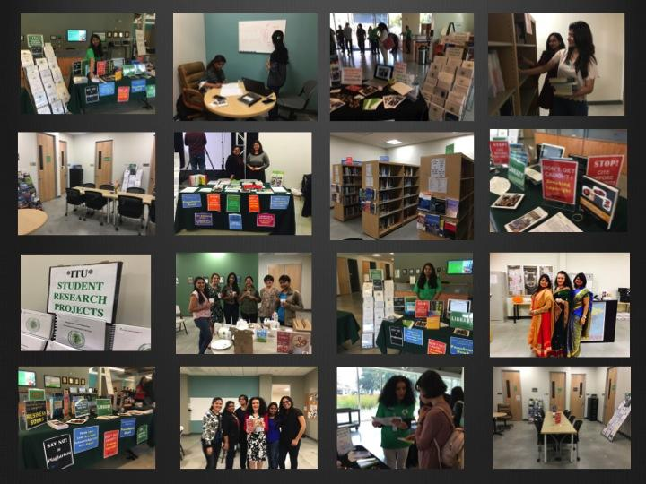
ITU Library Website
5/18/17

Slide 38
ADDITIONAL RESOURCES
ITU Library Website
5/18/17

Slide 39
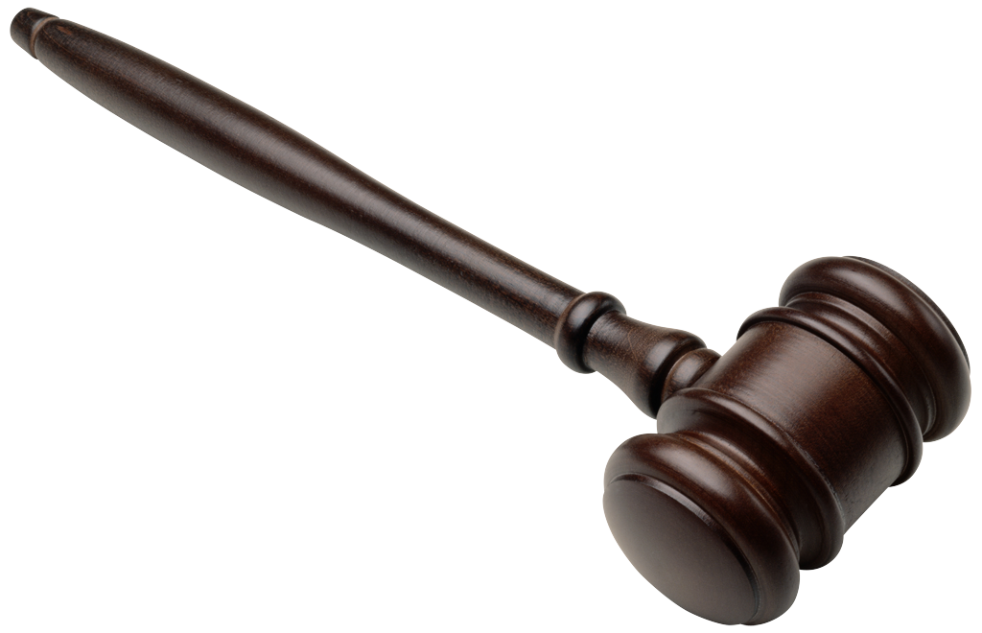
Criteria
Criteria | Tips
Authority / Publisher | contact details, expert? Opinionated? Credibility? Bias? No author? Red flag
Organization | .gov .edu .org .com .net; Contents, Index
Currency | Last updated? Active links? Evidence? Academic scholarly sources
Accuracy | Sources? Citations, Verified?
Coverage /Scope | Relevance, sufficient details
Objectivity / Bias | Opinion or fact? propaganda
Type of Information | Book, newspaper, image, blog, journal, website
Appropriateness | Task, audience, advertising (agenda)
ITU Library Website

Slide 40
Activity: How to evaluate websites & sources
Determine Website Credibility”
presented by Xtranormal
What makes sources lack credibility?
Write a ‘checklist’ for information credibility
What is a good way to narrow search results for more scholarly resources?
DISCUSS
How to cite YouTube
APA style:
[Auhor]. [Screen name]. (Year, Month Day). Title [Video file]. Retrieved from
ITU Library Website
5/18/17

Slide 41
Activity: ITU Library Subscriptions: Business Source Elite (EBSCO)
What is Business Source Elite?
How do I access Business Source Elite?
Log in to the EMS
Select E-Library tab in EMS
Offsite: Type in the id and password
Don’t have a login: email: library@itu.edu
Select ‘Advanced Search” feature
Apply your “strategy” by selecting and combining keywords and synonyms
5/18/17

Slide 42
Activity: ITU Library Subscriptions: NYTimes
What is the NYTimes Academic Pass?
How do I access NYTimes Academic Pass?
To access NYTimes register go to the following website.
Use your Student Email ID so that the NYTimes website can authenticate your credentials.
Log in through the EMS
Select E-library tab
https://myaccount.nytimes.com/register?URI=https%3A%2F%2Fmyaccount.nytimes.com%2Fverification%2Fedupass&OQ=
5/18/17

Slide 43
Activity ITU Library Subscriptions: ACM Digital Library
What is the ACM Digital Library?
How do I access ACM Digital Library?
Log in using the EMS
Offsite: Select E-library then “ACM Digital Library”
TYPE in ID [Fname] + Pswd [Lname]
Don’t have login? email: Email at library@itu.edu
Select “Advanced Search” feature
Apply your strategy by combining keywords (with Boolean operators)
5/18/17

Slide 44
RESOURCES FOR SELF STUDY
Information Literacy Why Is It Important (ACRL)
5 Components of Information Literacy
Why can’t I just Google?
Developing a Research Question
Data Information and Knowledge, by Charlie Broomfield
Determine Website Credibility (“The Hood”)
Credible websites (Detailed)
Eli Pariser: Beware online “filter bubbles” (Ethics)
LIS 665 Information Literacy Copyright Fair Use
What is information literacy? [Video]. ACRL, 2015
What is plagiarism anyway?
See APA Style Guide for correct formatting
ITU Library Website

Slide 45
RESOURCES FOR SELF STUDY
Virginia Tech Library [Research] Tutorials
Virginia Tech Library: Plagiarism
Johnson & Wales University APA Style Guide and J&W APA Examples.
Wikipedia's comprehensive comparison of reference management software
Dartmouth College Videos [for] Student Success
Dr. Martin Luther King, Jr. Library. Start your research
ITU Library Website
Georgia Tech: Finding raw data
See APA Style Guide for correct formatting
ITU Library Website

Slide 46
RESOURCES FOR SELF STUDY
Digital and information literacy in undergraduate teaching. London School of Economics (LSE), 2015
Assoc. of College Research Libraries (ACRL) 2000Information Literacy Competency Standards for Higher Education
Williamette University: Scholarly vs. Popular Website
Uni of CA, Santa Cruz: Primary vs. Secondary Website
Georgia Tech: Finding raw data Website
Copyright or wrong? A brief guide to copyright images video by Kyle Stedman. Video (YouTube)
Information Literacy Copyright Fair Use by Kim Allman, Youtube video by Powtoon
Publishing Your Graduate Work with UMI® by Proquest/UMI
Student’s Guide to Copyright & Fair Use by Univ. of Illinois
Copyright Basics for Graduate by Univ. of Oregon Website
See APA Style Guide for correct formatting
ITU Library Website

